Slide 1

Secure Online Voting and Election Management System
Guided by : Dr .P .vijayaragavan
Dr .Aruna
Course code : CSA0820
Course name : Python Programming for Scientific Computing
Presented by:
A. Roopesh Reddy(192512258)
B. Revanth Reddy(192524289)

Slide 2


Abstract
The “Secure Online Voting and Election Management System” is a Python-based application developed to provide a secure, transparent, and efficient method for conducting elections online. The system allows voters to register, log in securely, and cast their votes digitally while preventing unauthorized access and duplicate voting. It automates vote counting and result generation, reducing manual effort, errors, and time consumption. By using database management and authentication techniques, the project ensures data security, accuracy, and reliability, making it suitable for colleges, organizations, and small-scale election processes.

Slide 3

Introduction
The “Secure Online Voting and Election Management System” is designed to modernize the traditional voting process by providing a secure, efficient, and user-friendly digital platform for conducting elections.
Traditional voting methods often involve large amounts of paperwork, manual vote counting, time consumption, and risks of human error or malpractice.
This project aims to overcome these challenges by implementing an online system that allows voters to register, authenticate securely, and cast their votes electronically.
The system also enables administrators to manage candidates, voters, and election results effectively.

Slide 4
Problem Identification and Analysis
Stakeholders
Voters
Election Administrators
Candidates
Organizations conducting elections
Supporting Data/Research
Online voting reduces manual work.
Digital systems improve accuracy and speed.
Authentication methods increase security.
Automated counting provides faster results.
Description of the Problem
Traditional voting takes more time and manpower.
Manual vote counting may cause mistakes.
Risk of duplicate or fake voting exists.
Managing voter records manually is difficult.
Evidence of the Problem
Election results are often delayed.
Human errors affect voting accuracy.
Paper-based systems increase operational cost.
Security issues can reduce transparency.

Slide 5
Solution Design
The “Secure Online Voting and Election Management System” was designed and implemented using Python and database technologies to provide a secure and efficient election process.
The system includes modules for voter registration, secure login authentication, candidate management, vote casting, and automatic result generation.
The database stores voter and election information securely, while authentication mechanisms prevent unauthorized access and duplicate voting.

Slide 6
TOOLS AND TECHNOLOGIES USED
Tools and Technologies used:
Python – Main programming language used to develop the entire voting system.
Tkinter – Used to create the graphical user interface (GUI) for voters and administrators.
MySQL – Used as the database to store voter details, candidate data, and voting records.
Streamlit – Used for developing the web-based voting application and handling user requests.
VS Code– Used as the Python development environment for coding and testing.
Authentication Module – Implemented using Python to provide secure login and prevent duplicate voting.
Software Requirements:
Operating System – Windows, Linux, or macOS.
Python Interpreter – Required to execute Python programs.
Database Management System – MySQL for data storage.
IDE – VS Code for development.
Web Browser – Google Chrome for accessing the voting system.
Python Libraries – Libraries such as Tkinter, Flask, and SQLite connector for application development

Slide 7
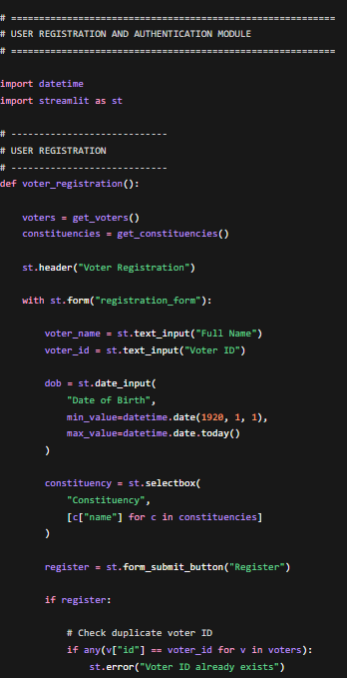
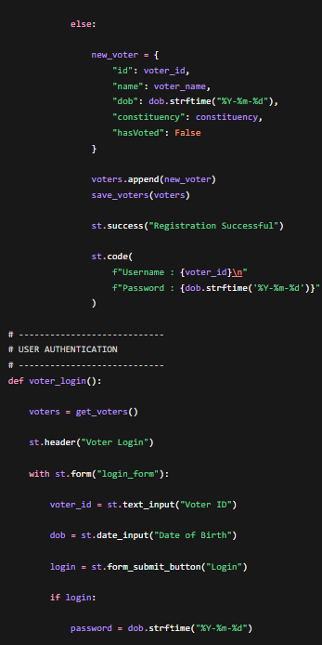
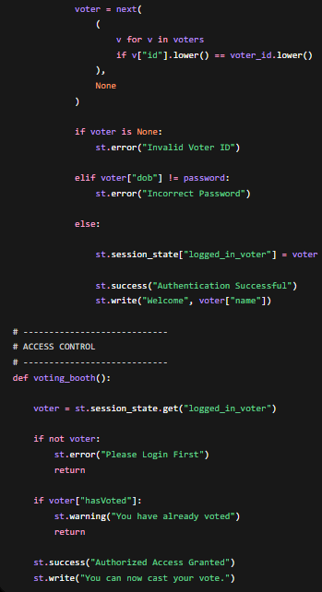
User Registration and Authentication Module
Registration: Users provide a username, password, and email, which are validated via Python for accuracy.
Secure Storage: Credentials are protected using password hashing and stored securely in a database or file.
Authentication: The system verifies login attempts by comparing entered details against stored encrypted data.
Access Control: Users are granted access upon a match; otherwise, the system denies entry and displays an error.
System Integrity: This workflow acts as a critical security layer for safe user management.

Slide 8
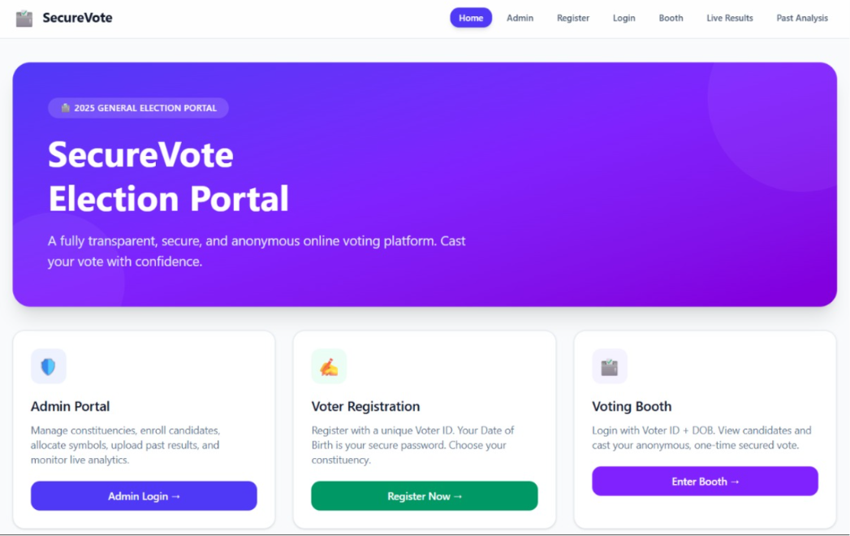
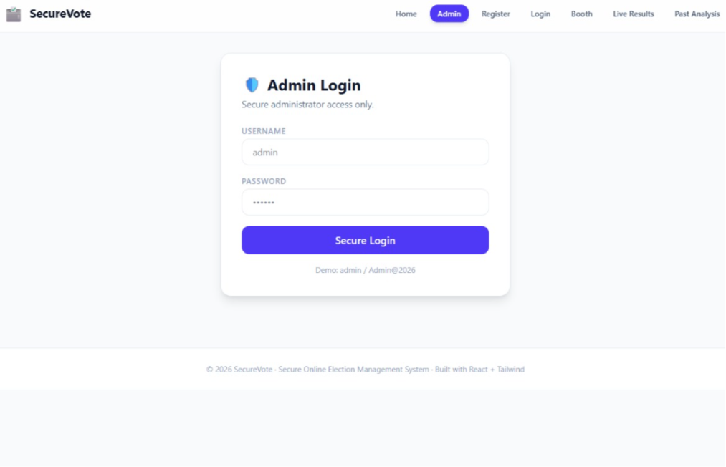
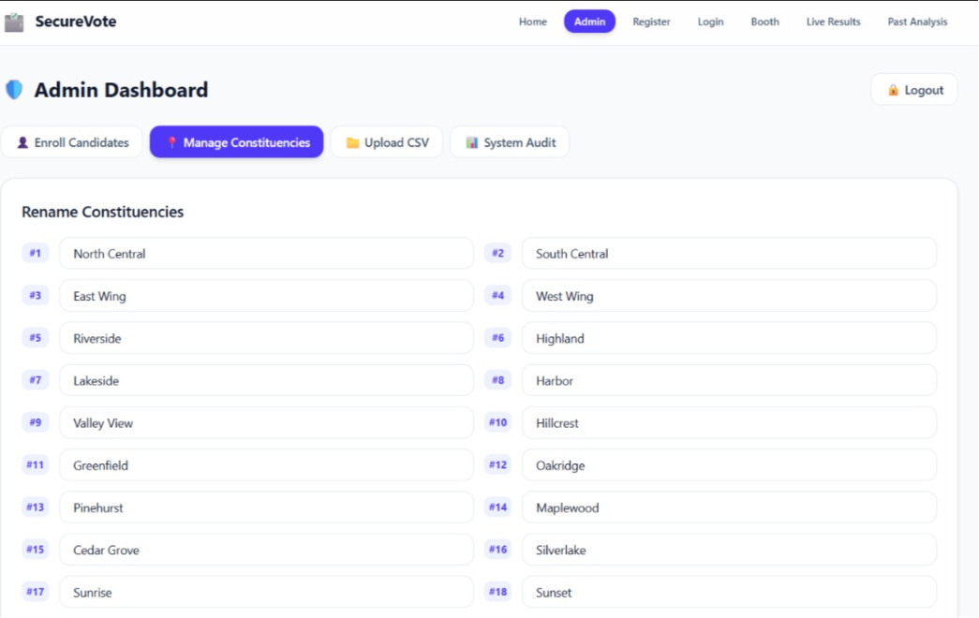

Slide 9
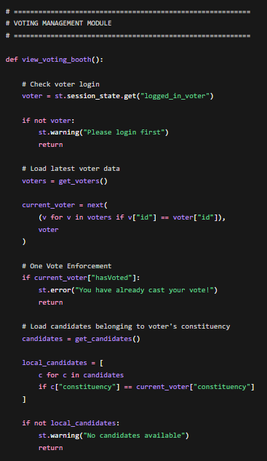
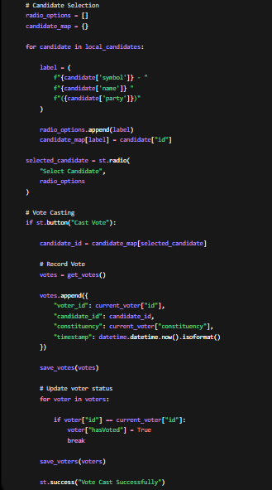
Voting Management Module
Voter Access: Authenticated users can view the list of election candidates.
Eligibility Check: The system verifies voter eligibility before accepting any submission.
Single-Vote Rule: Each voter is limited to one cast to prevent duplicate attempts.
Secure Storage: Votes are recorded in a secure database to ensure confidentiality and data integrity.
Core Purpose: Provides a structured and secure framework for the entire voting process.

Slide 10
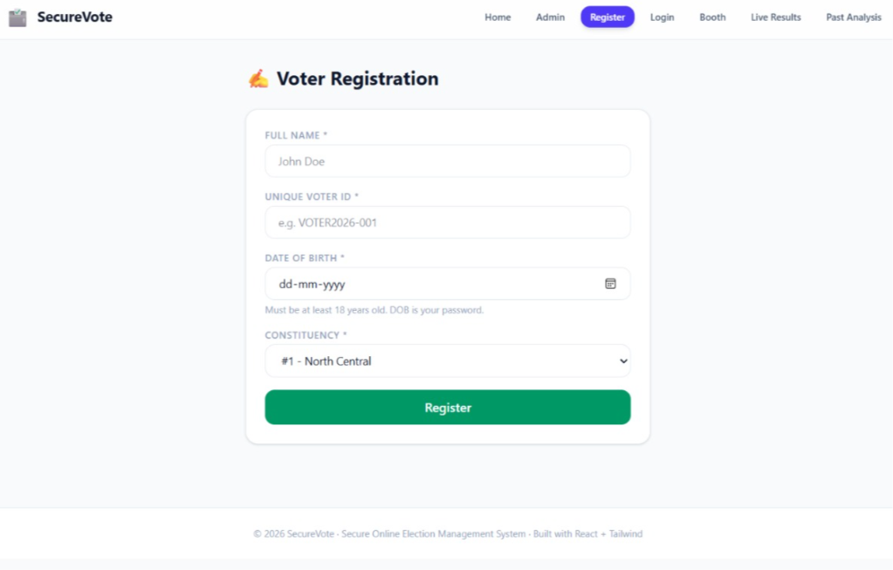
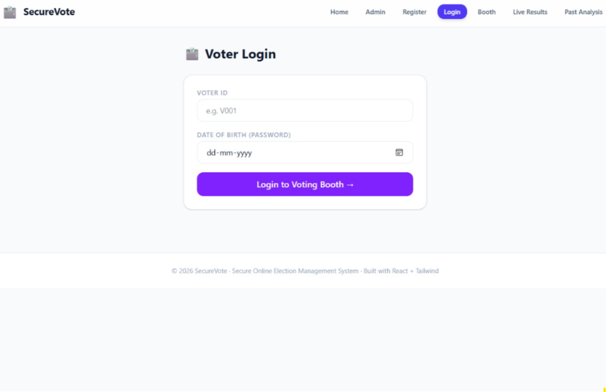

Slide 11
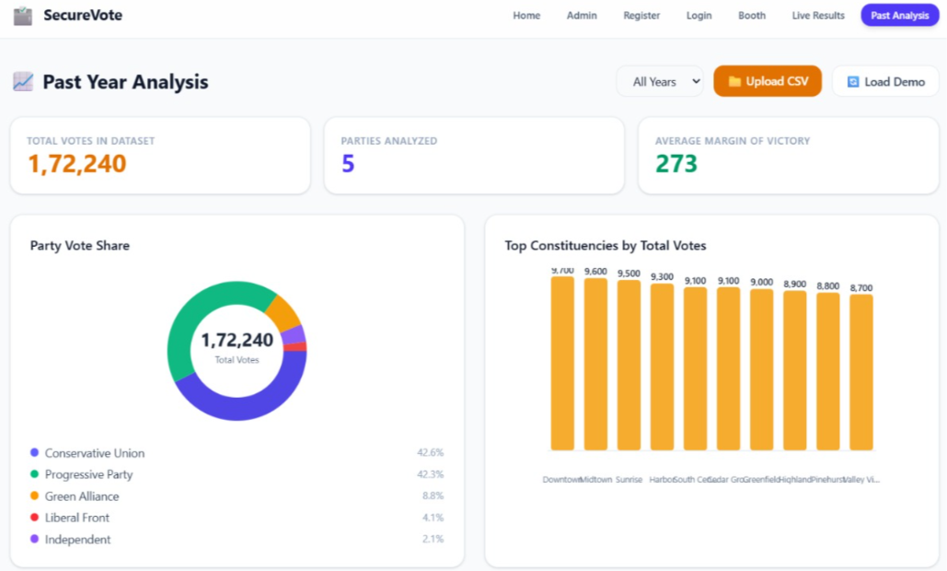
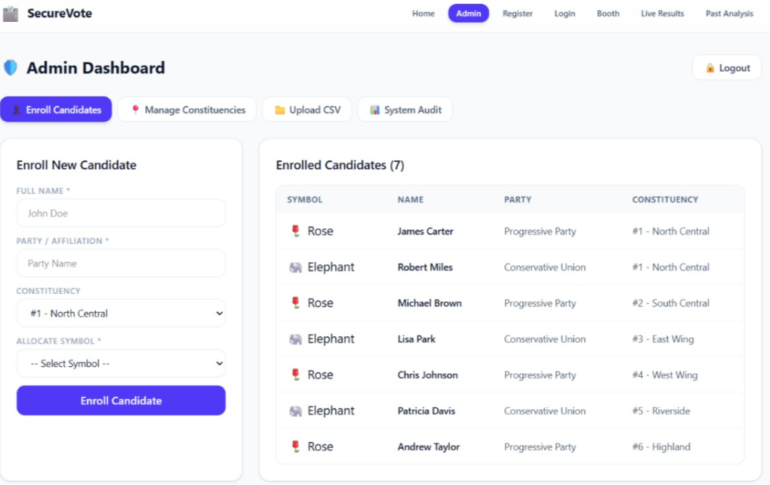
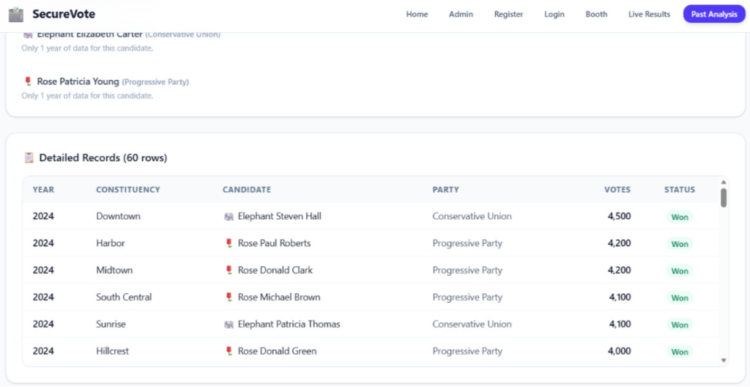
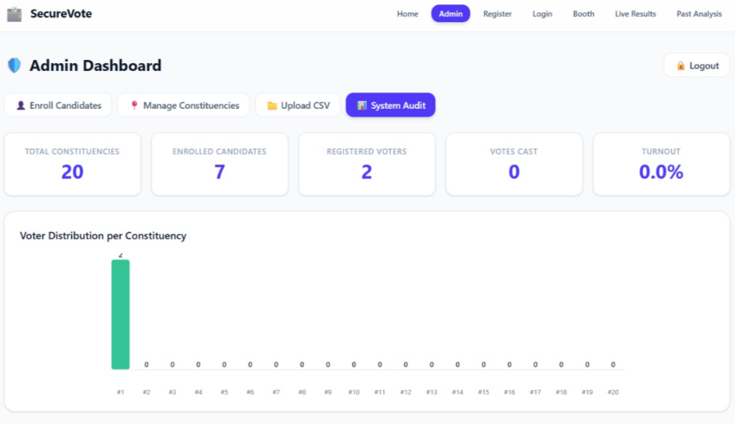

Slide 12
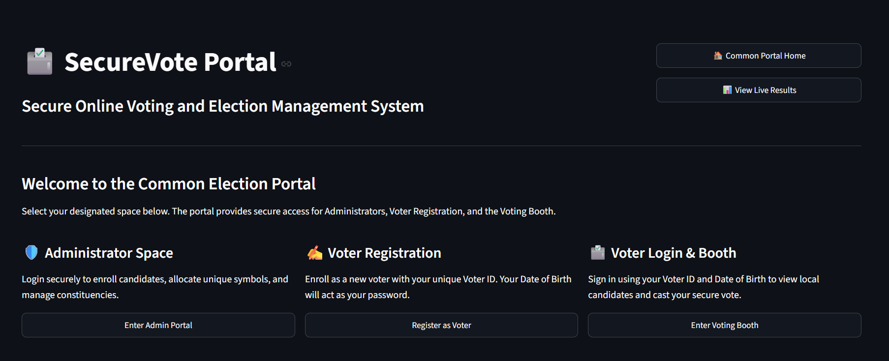
Results and Discussion
The Secure Online Voting and Election Management System successfully demonstrates a reliable and efficient platform for conducting digital elections.
It effectively prevents duplicate voting and unauthorized access, maintaining the integrity of the election process.
The results show accurate vote counting and real-time result generation, improving transparency and reducing manual effort.

Slide 13
Reflection on Learning and Personal Development
Gained practical knowledge of secure system design using Python
Learned user authentication and data encryption techniques
Improved programming and problem-solving skills through real implementation
Understood prevention of issues like unauthorized access and duplicate voting
Strengthened overall knowledge of cybersecurity and system development concepts

Slide 14
Conclusion
The Secure Online Voting and Election Management System provides a reliable, efficient, and secure approach to conducting digital elections using Python.
The system successfully integrates key functionalities such as user registration, authentication, vote casting, and result management while ensuring data security through encryption and validation techniques.
It effectively prevents unauthorized access and duplicate voting, thereby maintaining the integrity and transparency of the election process.
Overall, the project demonstrates how technology can enhance the traditional voting system by making it more accurate, faster, and trustworthy, while ensuring fairness and security in the entire election process.

Slide 15
References
Wang, X., Feng, T., Liu, C., & Fang, J. (2024). Multi party confidential verifiable electronic voting scheme based on blockchain. Journal of Cloud Computing, 13(160). Springer Nature.
Singh, I., Kaur, A., Agarwal, P., & Idrees, S. M. (2024). Enhancing Security and Transparency in Online Voting through Blockchain Decentralization. SN Computer Science, 5(921). Springer Nature.
Wang, B., Guo, F., Liu, Y., & Yuan, Y. (2024). An efficient and versatile e-voting scheme on blockchain. Cybersecurity, 7(62). Springer Nature.
Rahman, K. N., Hridoy, M. W., Rahman, M. M., Islam, M. R., & Banik, S. (2024). Highly secured and effective management of app-based online voting system using RSA encryption and decryption. Heliyon, 10(3), e25373.
Joni, S. A., Rahat, R., Tasnin, N., Ghose, P., Uddin, M. A., & Ayoade, J. (2024). Hybrid-Blockchain-Based Electronic Voting Machine System Embedded with Deepface, Sharding, and Post-Quantum Techniques. Blockchains, 2(4), 366–423.

Slide 16


